Slide 1
Introduction to Git and GitHub
Initiating HacktoberFest :

Slide 2


About Speakers
Aman Singh Kushwaha
Aryan Singh
UIT-RGPV Bhopal, IT 2yr
GDSC Buddy, OpenSource Enthusiast
UIT-RGPV Bhopal, CSE 2yr
Core Team @GDSC UITRGPV,
GoLang Developer

Slide 3
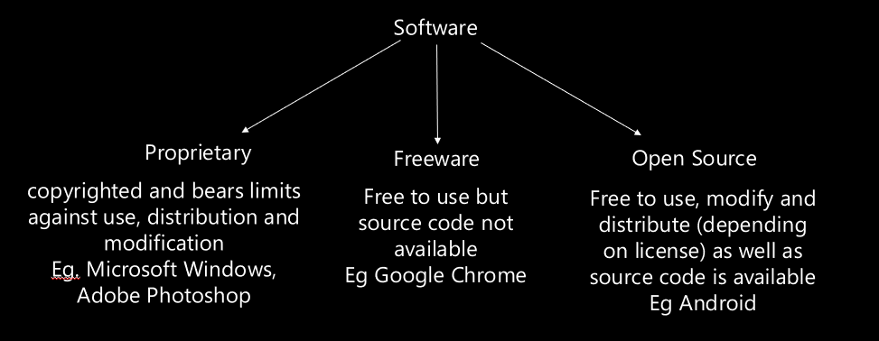

Slide 4






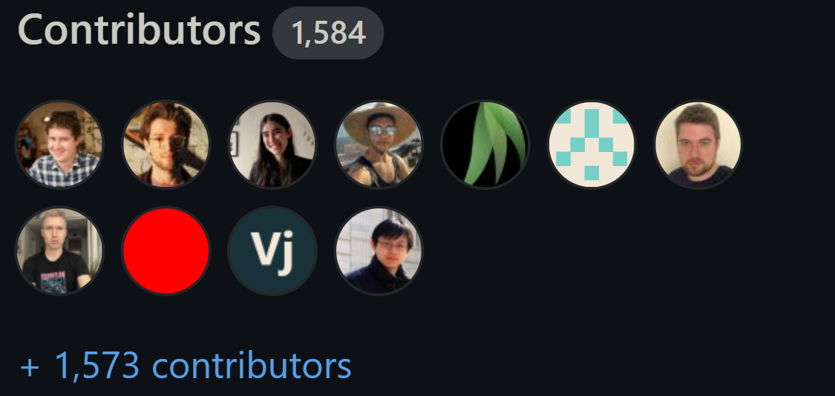
WHAT IS Opensource??
Project:
A product whose source code is freely available for all, anyone around the world can make changes revelent to it.
Contribution:
When you make changes which can be code or non-code by raising revelent issue, your changes got merged

Slide 5

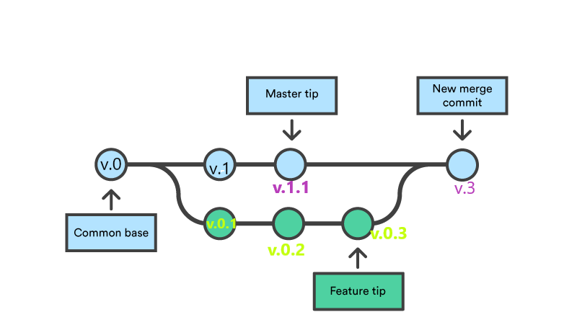
What is Version Control Systems(VCS)
When 1000+ people are contributing to same project how does Project’s Version is managed and shared simultaneously ?
How can we keep records of changes in our project which made 1000+ peoples ?
Here VCS comes to help
Some Examples:
Git , GitLab, BitBucket

Slide 6
What is Git an GitHub ?
Git is a version control system for tracking changes in computer files and is used to help coordinate work among several people on a project while tracking progress over time. In other words, it’s a tool that facilitates source code management in software development.
It provides Git Bash which is a CLI used to run git commands
Github is VCS and cloud based hosting service which helps to store and share code across world

Slide 7


Setting up Git and GitHub
Install Git
https://git-scm.com/downloads
2. Make GitHub account
3. Open Git Bash (After installing Git)
4. Run Command
git config --global user.name “YourUserName”
Press Enter
git config --global user.mail “YouEmailID”
Press Enter
5. Open Git Bash in folder you want and initialize git (connecting git with folder) with command
git init
Now you are ready to Code/Contribute ..

Slide 8
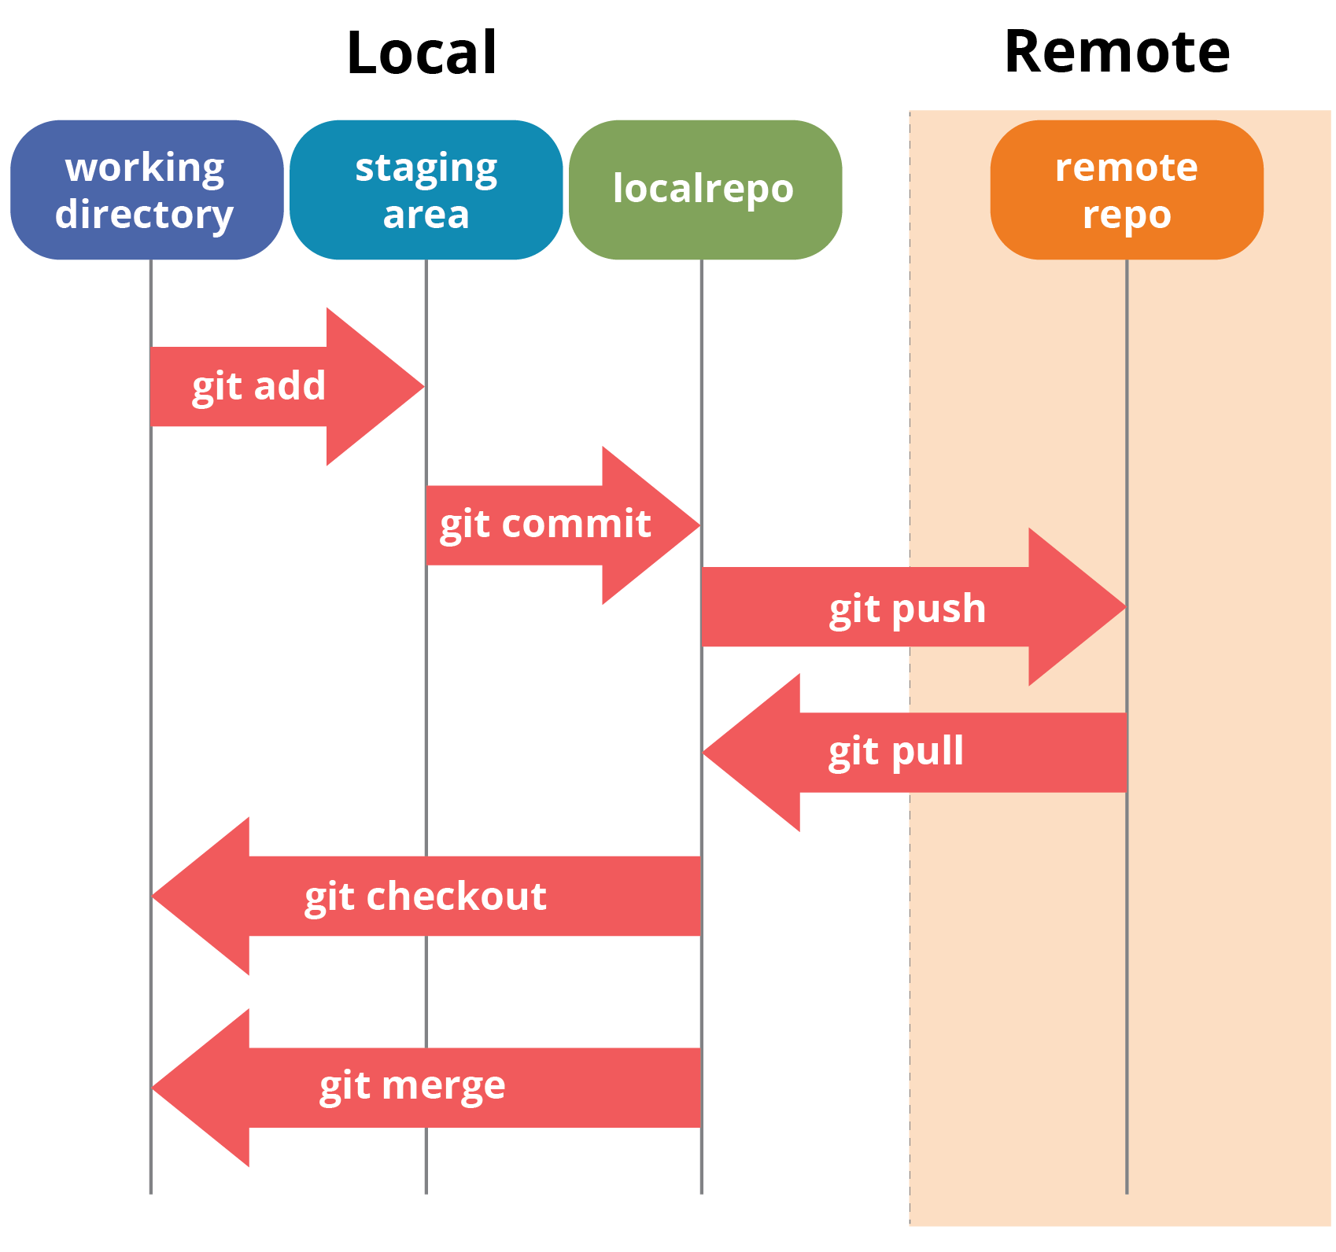
Understanding Git Commands
Git fetch
Git clone

Slide 9



Slide 10

Explore by Yourself
⬤ GitHub Student Developer Pack
⬤ GitHub Education
⬤ learngitbranching.js.org
⬤ Hacktoberfest.com

Slide 11


Slide 12


Do you have any questions?
We are here to clear all your doubts!!!

Slide 13


